Slide 1
16-BIT MULTIPLICATION
EXP NO: 7
AIM:To write an assembly language program to implement 16-bit division using 8086 processor.
ALGORITHM:
1) Start the program by loading a register pair with the address of memory location. 2) Move the data to a register. 3) Get the second data and load it into the accumulator. 4) Subtract the two register contents. 5) Increment the value of the carry. 6) Check whether the repeated subtraction is over. 7) Store the value of quotient and the reminder in the memory location. 8) Halt.
PROGRAM:
LHLD 2050
SPHL
LHLD 2052
XCHG
LXI H,0000H
LXI B,0000H
AGAIN: DAD SP
JNC START
INX B
START: DCX D
MOV A,E
ORA D
JNZ AGAIN
SHLD 2054
MOV L,C
MOV H,B
SHLD 2056
HLT

Slide 2
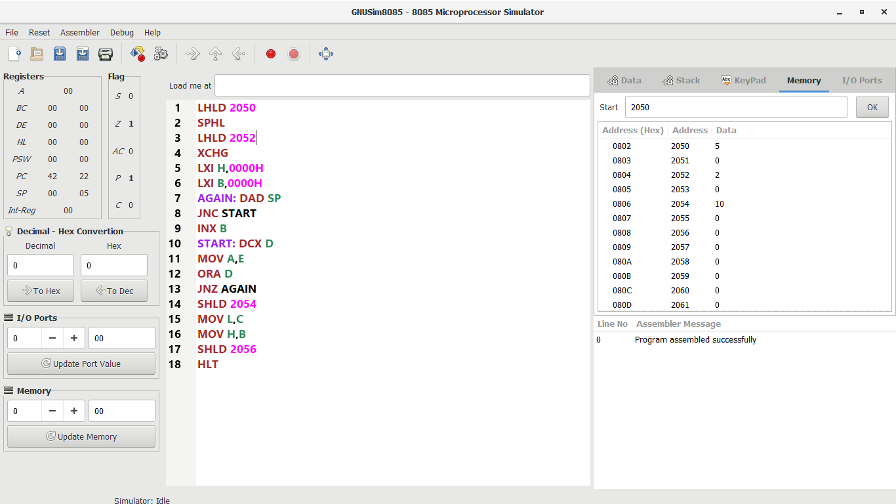
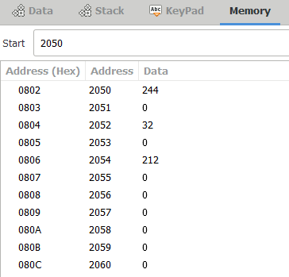
INPUT:
OUTPUT:

Slide 3
RESULT: Thus the program was executed successfully using 8086 processor simulator.

